Slide 1

Adaptive Motion Planning with Artificial Potential Fields (APF) for UGVs: Dynamic and Static Target Tracking with Obstacle Avoidance
CSCI 6550: Intelligent Agents
Padam Jung Thapa

Slide 2
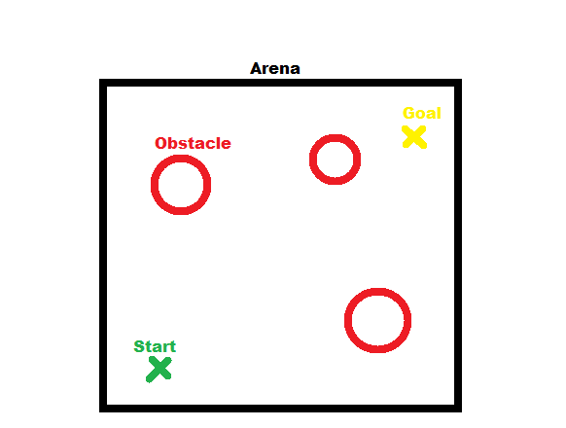
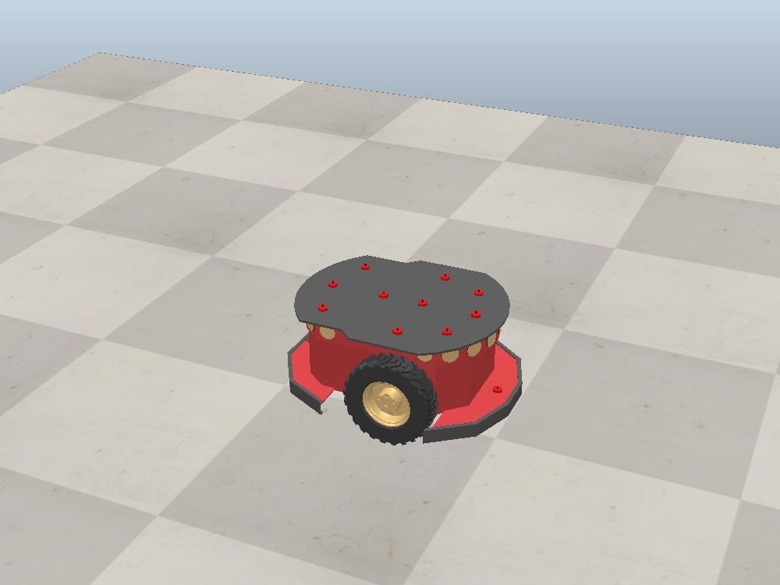
Motivation
The field of robotics has significantly advanced in autonomous navigation and obstacle avoidance strategies.
This project focuses on implementing the Artificial Potential Field (APF) method for a mobile robot in CoppeliaSim.
Goal: To enable the robot to pursue both static and dynamic targets while avoiding obstacles, showcasing real-time adaptation and effective path tracing capabilities.
Notes:
Collision avoidance strategies in motion/path planning are essential for ensuring that vehicles, robots, or other autonomous systems can navigate through their environment safely without colliding with obstacles. We have global and local planning methods where global planning methods involve creating a plan for the entire path from start to finish before the vehicle begins to move which typically requires a complete and accurate map of the environment. Graph Search Algorithms (A*, D*, Dijkstra’s Algorithm), Sampling Based Planning (PRM, RRT), etc. falls into this category. On the other hand, Local planning methods, also known as reactive methods, involve making decisions on-the-fly based on sensor data and the current situation which includes Potential Field Methods, Vector Field Histogram (VFH, VFH+), Dynamic window approaches.

Slide 3
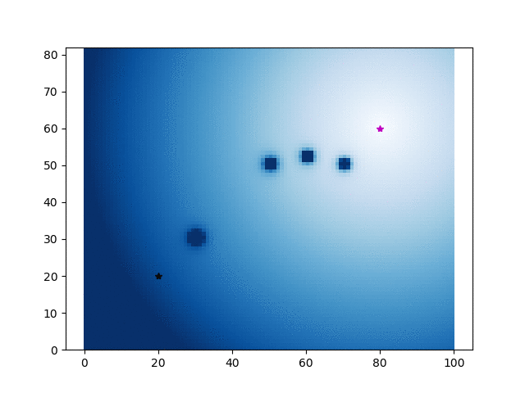
Objective
Enhance the APF algorithm for the Pioneer P3dX mobile robot to effectively trace paths and avoid obstacles.
Reach a fixed goal.
Follow a dynamic target.
Notes:
Implement the technique of potential fields with gradient descent
The image provided is a static representation of an APF scenario, where we can see a gradient field that likely represents the potential field generated by the attractive and repulsive forces. The darker areas indicate higher repulsive potentials from obstacles, while the lighter areas suggest lower potential, making them more favorable paths for the robot to follow
Address the simplicity and real-time application capabilities of the APF method.
Previous studies have explored various obstacle avoidance strategies, including geometric methods, Bug algorithms, Vector Field Histogram (VFH), and Dynamic Window Approach (DWA).
The APF method, despite its simplicity, has faced criticism for issues like local minima. Recent advancements aim to mitigate these issues through hybrid approaches or modifications to the potential field functions.

Slide 4
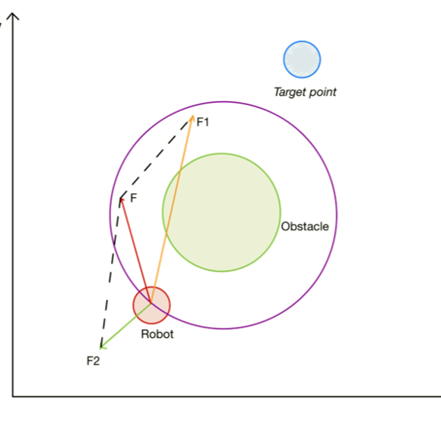
Artificial Potential Field
AFP is a scalar field that guides a robot's motion by assigning a value to each point in the environment, representing the potential energy at that point.
Virtual Forces Used:
Attractive Force (F1)
Repulsive Force (F2)
Notes:
The APF method uses two types of virtual forces: an attractive force pulling the robot towards the goal and a repulsive force pushing it away from obstacles.
The combination of these forces dictates the robot's motion, aiming to achieve a balance that guides the robot safely to its target.
an attractive force that pulls the robot towards the goal, and a repulsive force that pushes the robot away from obstacles.
Attractive forces are typically defined as a function of the distance between the robot and the goal. The closer the robot is to the goal, the stronger the attractive force.
Repulsive forces are typically defined as a function of the distance between the robot and an obstacle. The closer the robot is to an obstacle, the stronger the repulsive force.

Slide 5
Attractive/Repulsive Potential Field
U(q) = U_att (q) + U_rep (q)
U_att is the "attractive" potential
Move towards the goal
U_rep is the "repulsive" potential
Avoid obstacles
Further Improvements:
Integration of VFH+ plugin for improved obstacle avoidance.
Integration of Occupancy Grid Maps for Detailed Environment Representation.
Notes:
an attractive force that pulls the robot towards the goal, and a repulsive force that pushes the robot away from obstacles. The attractive force is a function of the robot's distance and bearing to the target, while the repulsive force depends on the robot's proximity and orientation relative to nearby obstacles
F1 represents the attractive force directed towards the target,
F2 symbolizes the repulsive force exerted by an obstacle,
and the vector F is the net/resultant force that dictates the robot's motion, resulting from the combination of F1 and F2
Vector Field Histogram – helps navigating in complex environments with tighter maneuvering and smoother paths.
OGM refers to the use of a specific type of map that allows robots to understand and navigate their surroundings with a high level of detail

Slide 6
References:
[1] Sung, Nakyeong, Suhwan Kim, and Namsuk Cho. 2023. "An Efficient Path Planning Algorithm Using a Potential Field for Ground Forces"
[2] Zhang et. al. “Articial potential eld based anti-saturation positioning obstacle avoidance control for wheeled robots”
[3] https://www.cs.cmu.edu/~motionplanning/lecture/Chap4-Potential-Field_howie.pdf
[4] https://github.com/AtsushiSakai/PythonRobotics/
[5] Ana Batinovic, Jurica Goricanec, Lovro Markovic, Stjepan Bogdan. 2023 “Path Planning with Potential Field-Based Obstacle Avoidance in a 3D Environment by an Unmanned Aerial Vehicle”.
[6] Iswanto, Alfian Ma’arif. 2019 “Artificial Potential Field Algorithm Implementation for Quadrotor Path Planning”

Slide 7

Questions?

